Slide 1
Tokyo Stock Prices
Adam Foster
Maciek Staniszewski

Slide 2
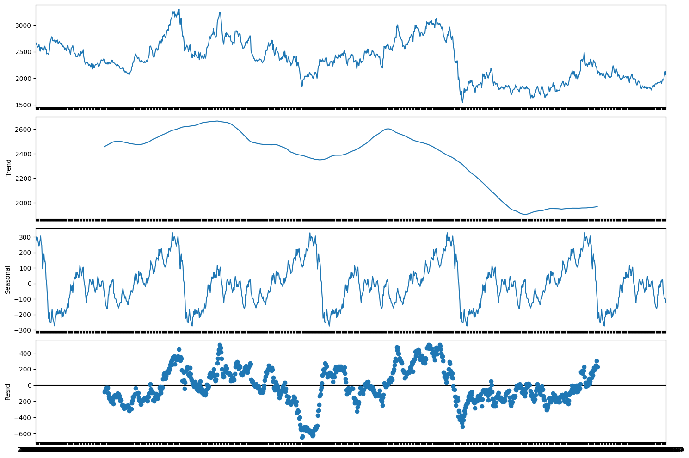
Tokyo Stock Exchange Data
Data from 2017 to 2022
Huge 1.3 GB dataset, restricted to one time series of “Japan Petroleum Exploration”
Predicting Close instead of Returns
Eliminating negative observations
No clear deterministic trend
Strong yearly linear seasonal effects
Residuals distributed around 0, expected for a linear model

Slide 3
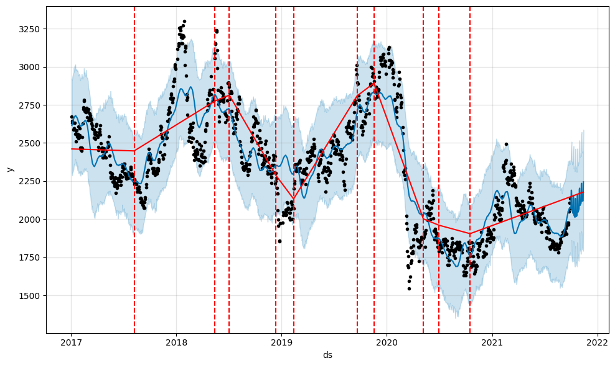

Prophet
Last 45 observations removed from the training dataset
Prophet fits the in-sample data very well
Avoids overfitting and doesn’t accurately model sudden spikes
Models stable progressions well
Identifies 10 trend changepoints
Forecast is jumpy, but follows the general pattern.
Accounting for holidays has no effect on prediction due to how the stock market operates

Slide 4
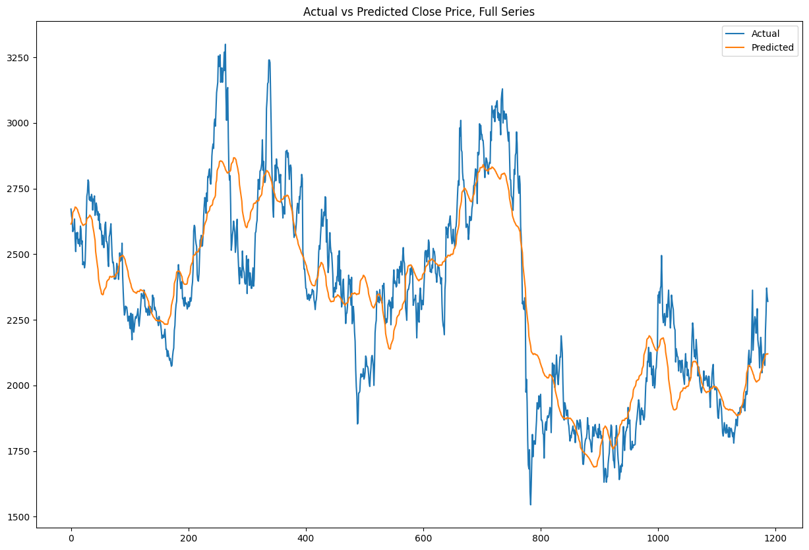
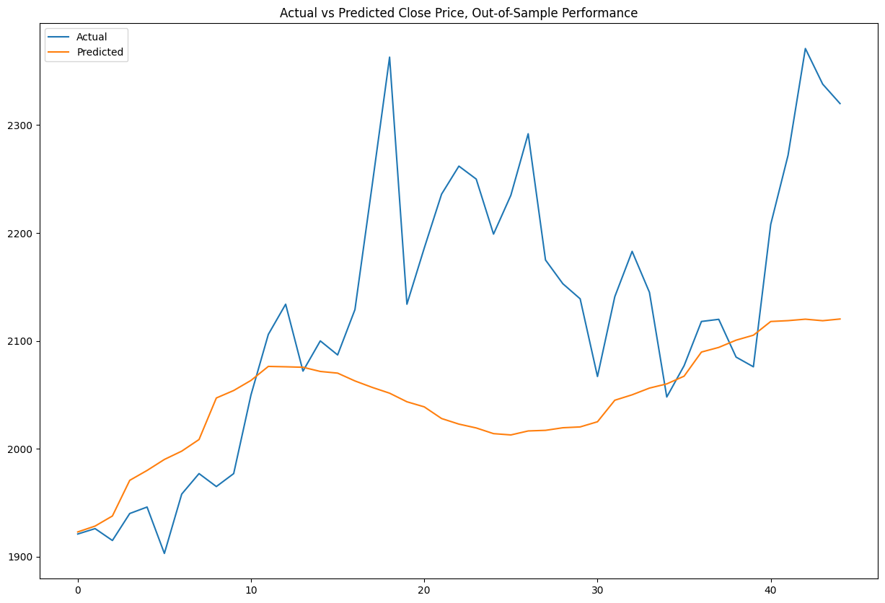
Prophet - Fitting and Predictions
MAE = 124.8, MAPE = 5.4%
MAE = 100.6, MAPE = 4.6%

Slide 5
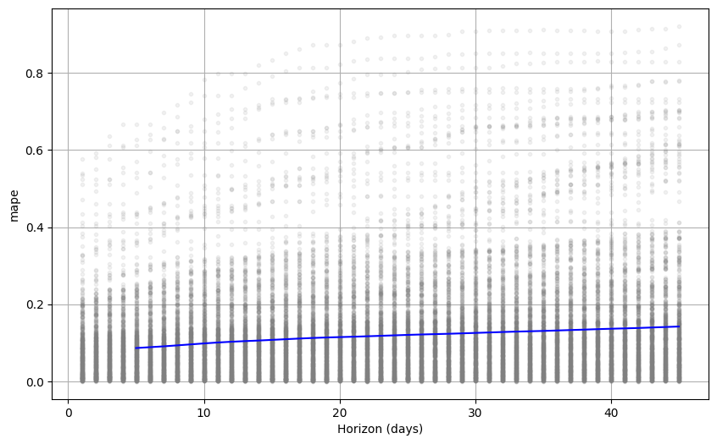
Prophet - CV
Our previous MAPE score smaller than 5% depended on favourable plateau in the Close price
The MAPE resulting from cross validation averaged at ~18%
MAPE was steadily increasing proportionally to the increase of the horizon.

Slide 6

Orbit
We tested three State Space Models supported by Orbit:
Exponential Smoothing (ETS): MAPE = 6.7%
Local Global Trend (LGT): MAPE = 7.2%
Damped Local Trend (DLT): MAPE = 6.9%
All three models performed similarly in the out-of-sample period. ETS was the best at picking up a sudden price jump, while DLT was steadily trending downwards.

Slide 7
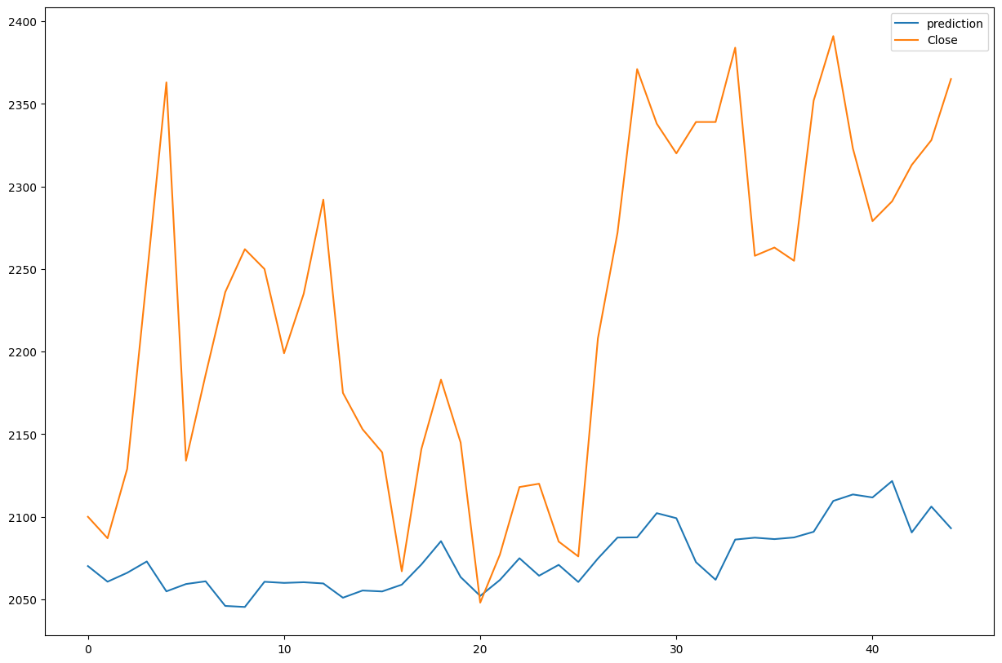
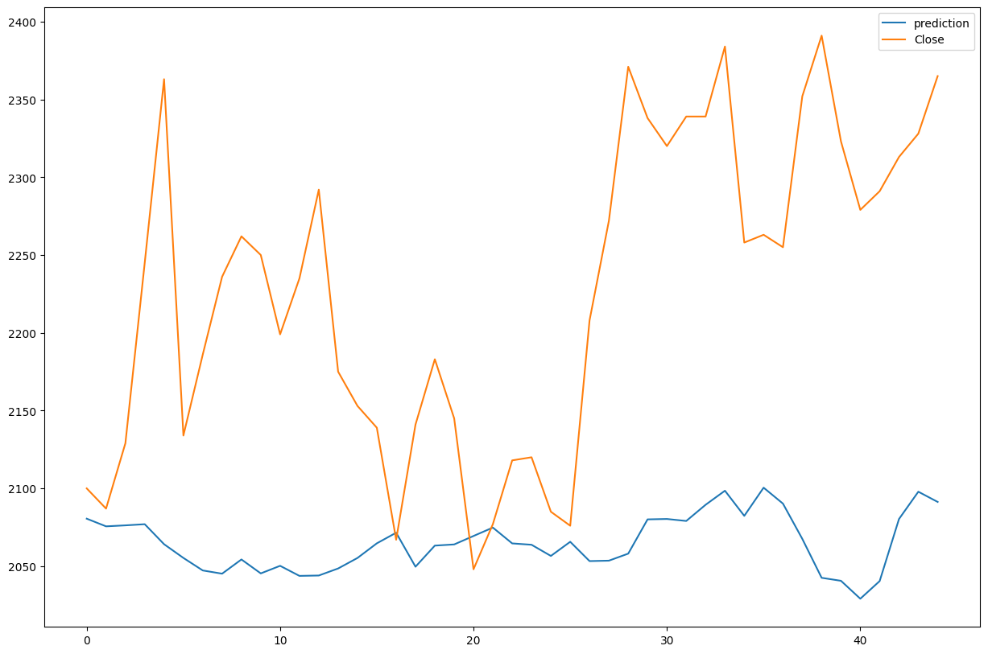
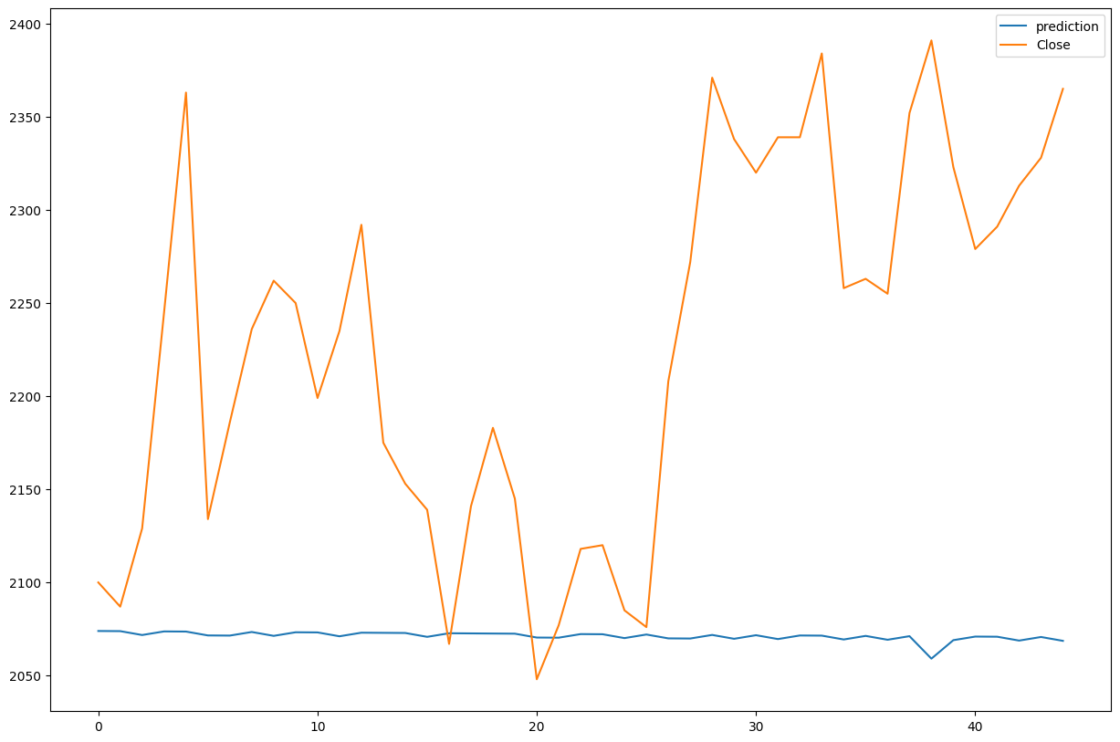
Orbit - Model Evaluation
Exponential Smoothing
Local Global Trend
Damped Local Trend

